Slide 1
The Laplace Transform of Integral, Differential Equations, IVP
Notes:
The method of Laplace transforms is a system that relies on algebra (rather than calculus-based methods) to solve linear differential equations. While it might seem to be a somewhat cumbersome method at times, it is a very powerful tool that enables us to readily deal with linear differential equations with discontinuous forcing functions.

Slide 2
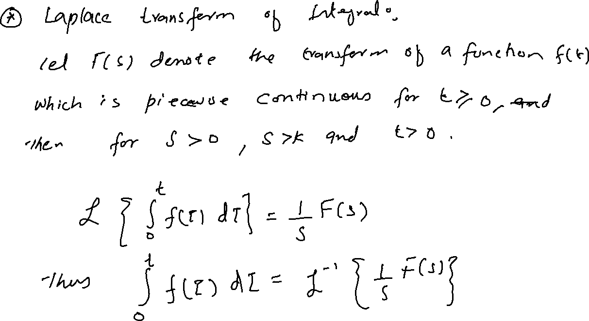

Slide 3
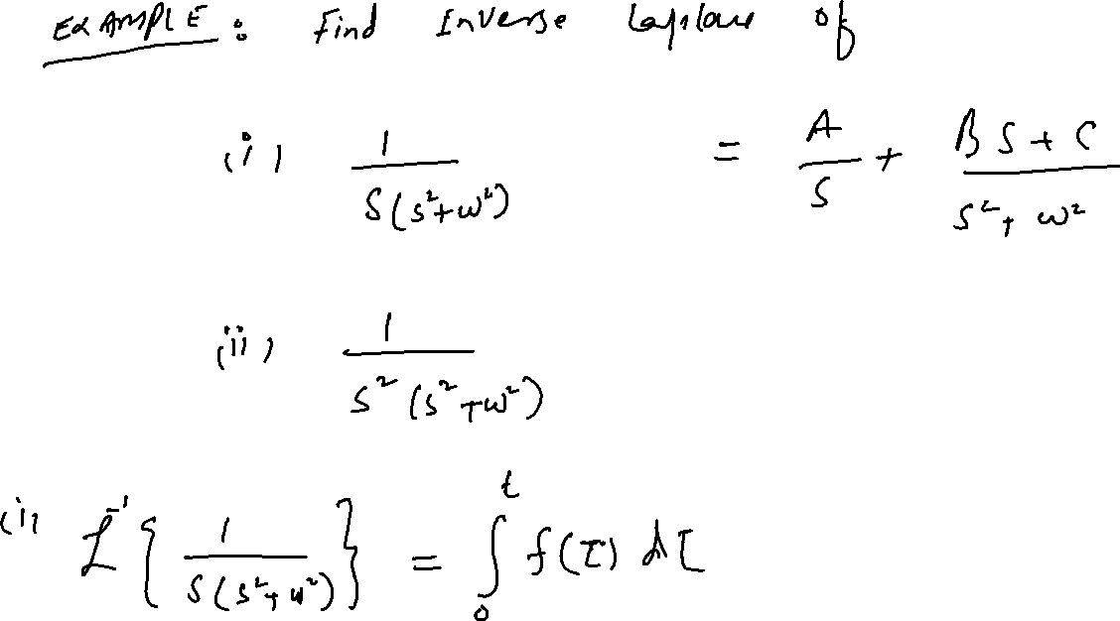

Slide 4















Slide 5










Slide 6
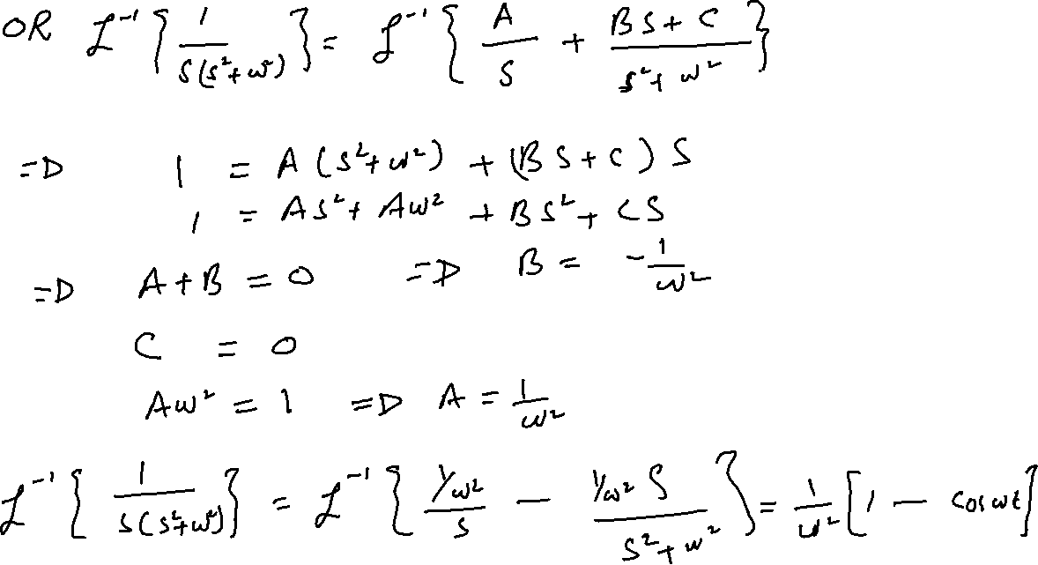

Slide 7
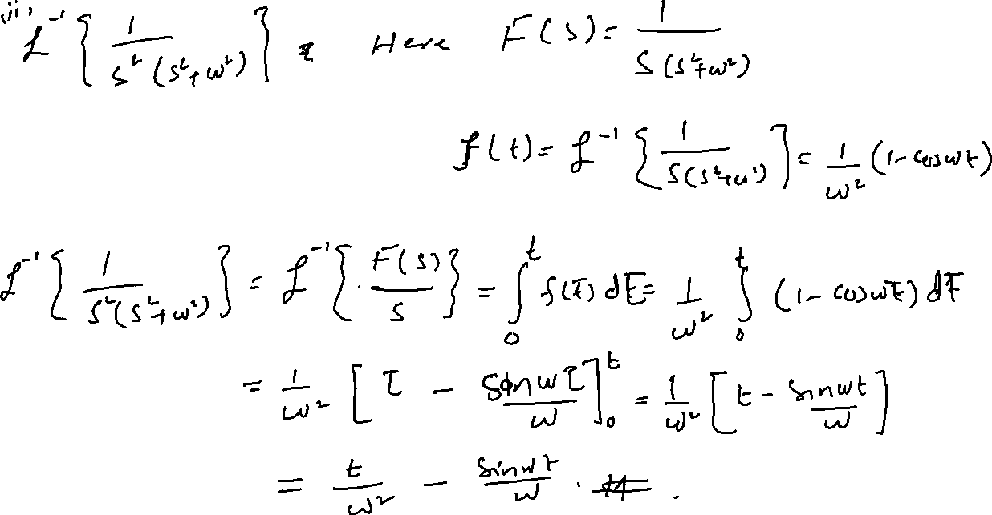

Slide 8
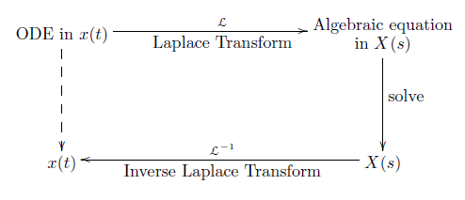

Ordinary Differential Equations
One application of the Laplace transform is to solve differential equations. In this section, we consider ordinary differential equations or ODEs. The schema behind the use of Laplace transforms to solve ODEs is shown in the following diagram:

Slide 9


Slide 10
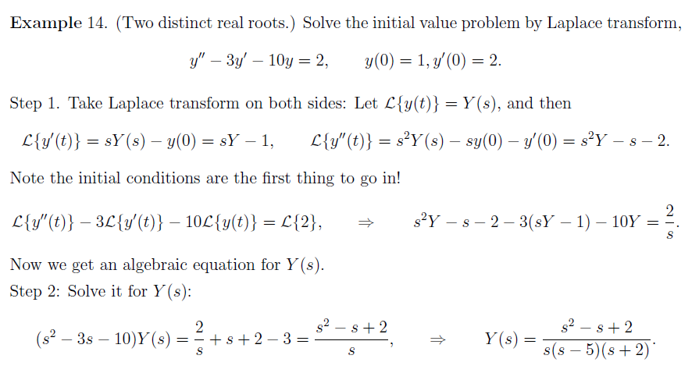
Solutions of initial value problems: Partial Fraction

Slide 11
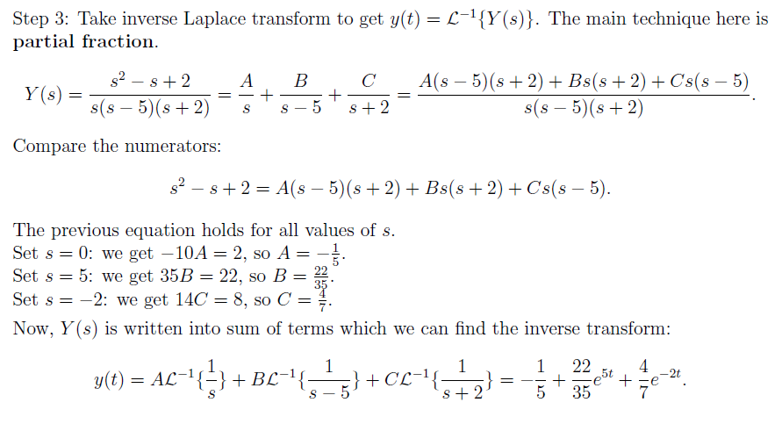

Slide 12
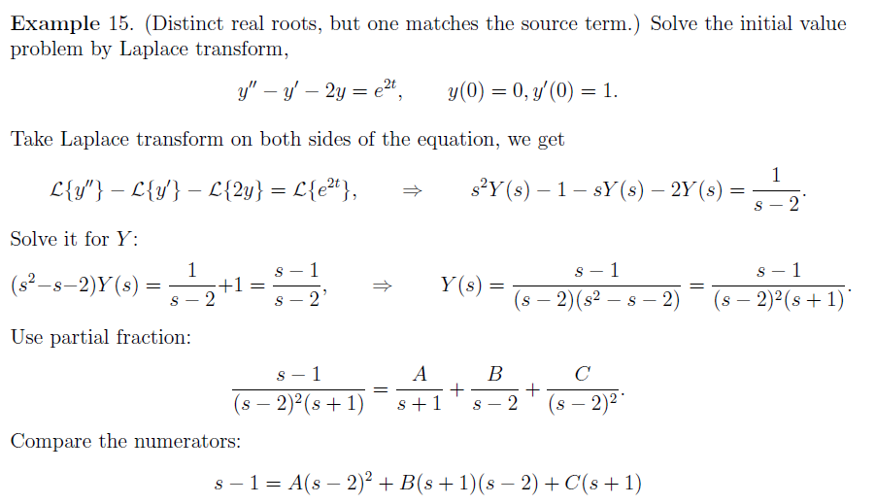

Slide 13
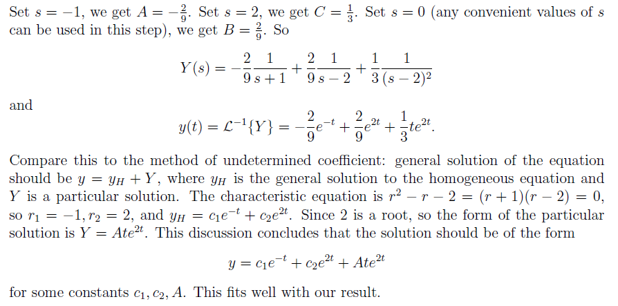

Slide 14



Slide 15
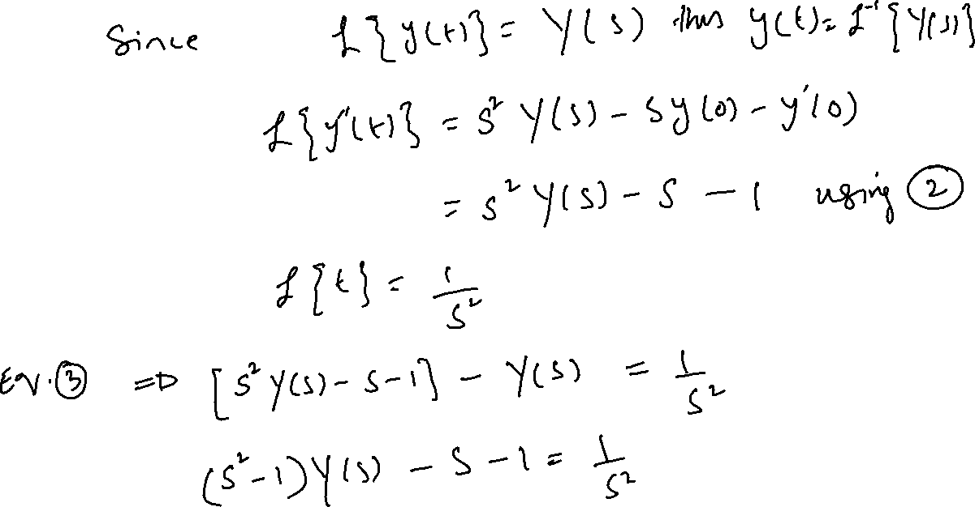

Slide 16
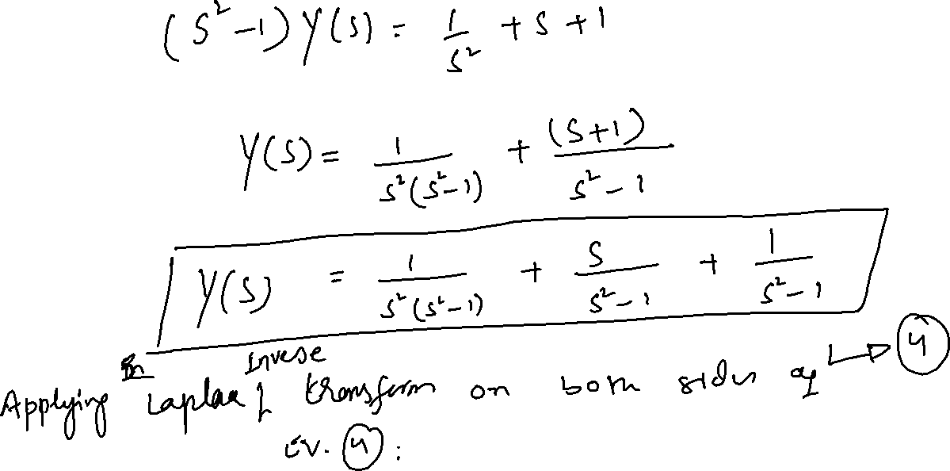

Slide 17
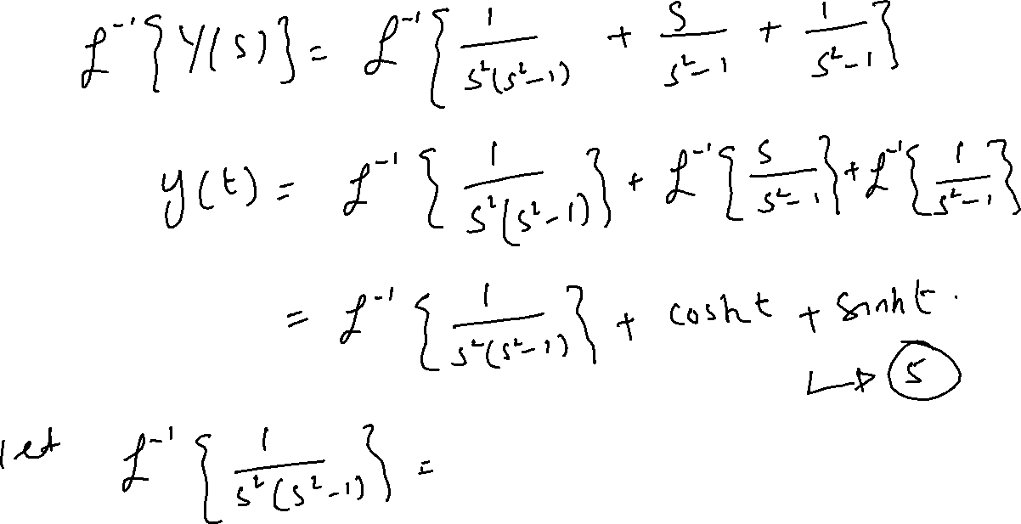

Slide 18
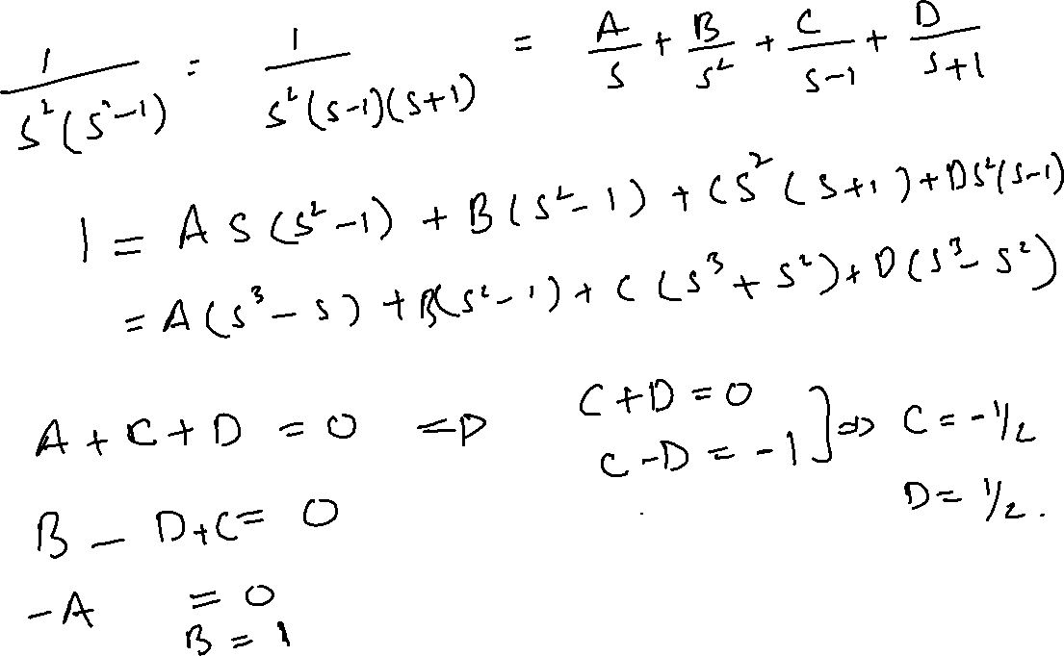

Slide 19
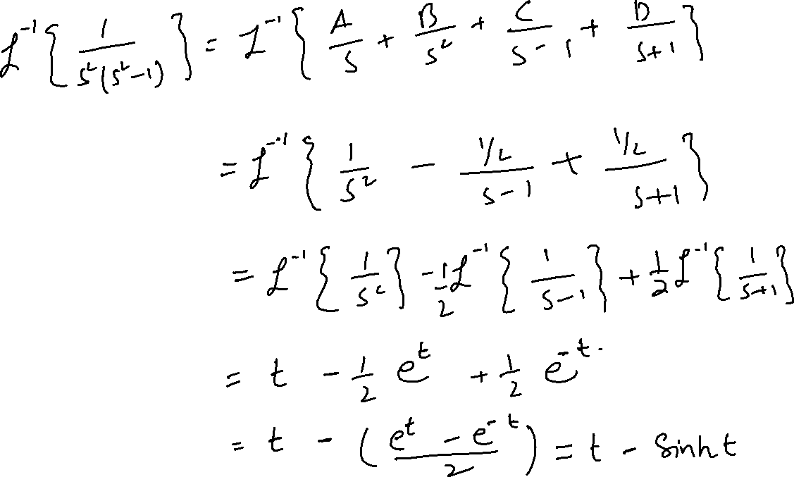

Slide 20
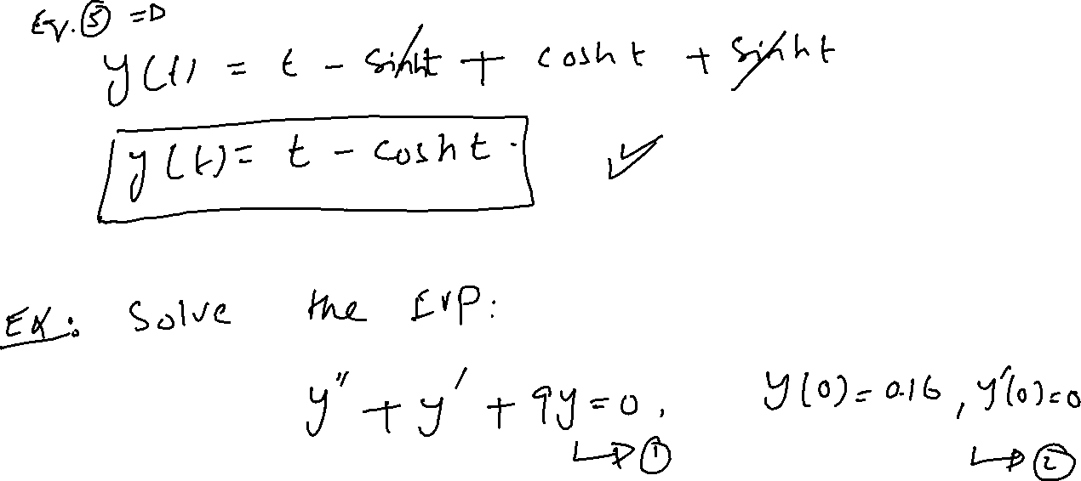

Slide 21



Slide 22
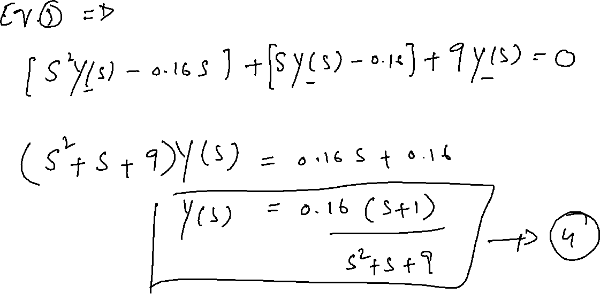

Slide 23
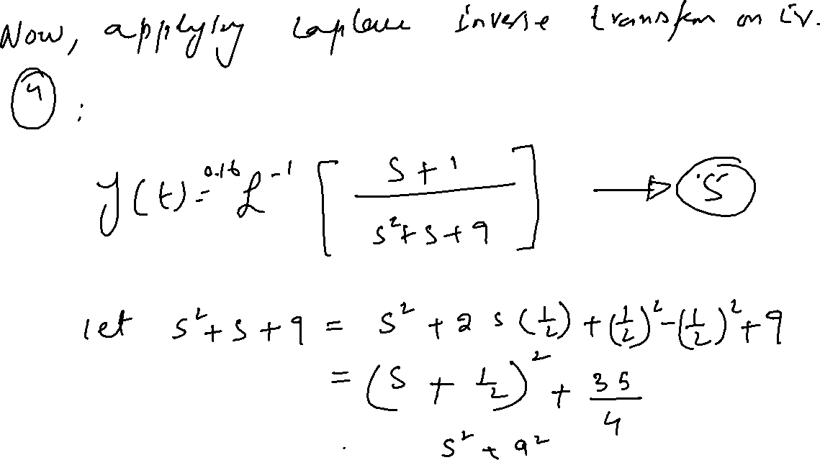

Slide 24
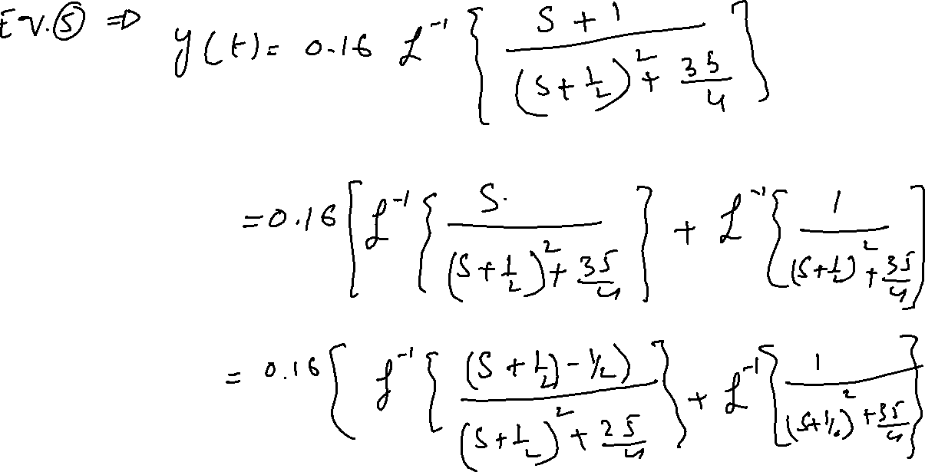

Slide 25
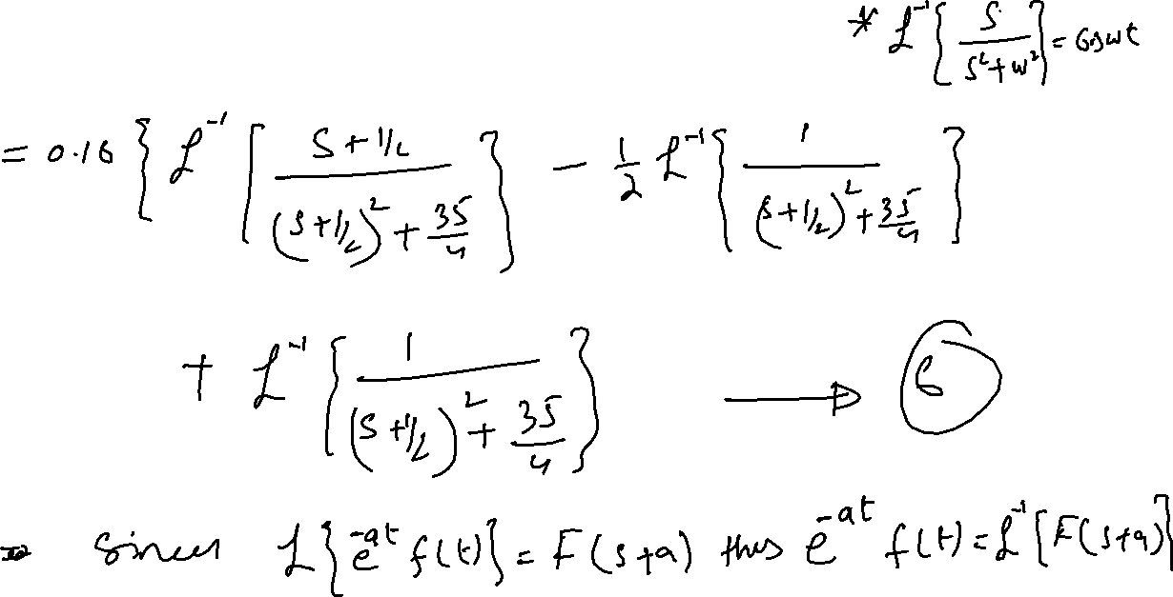

Slide 26
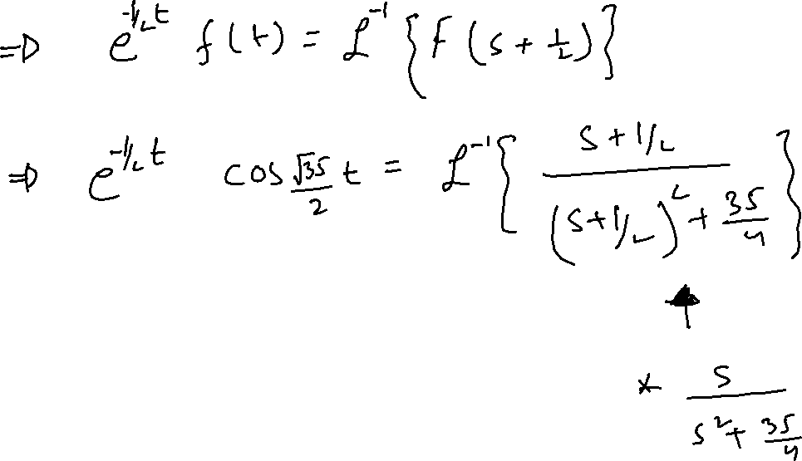

Slide 27
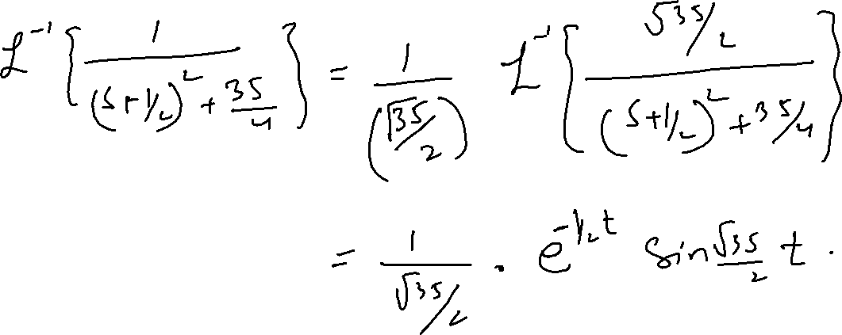

Slide 28
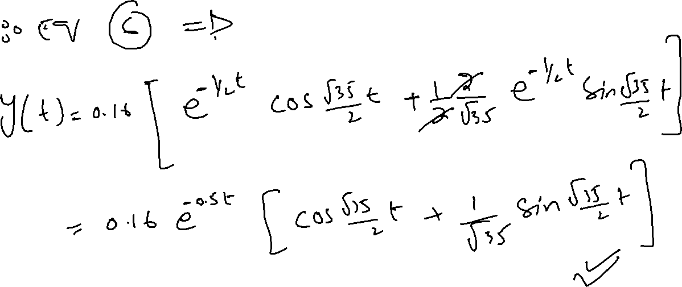

Slide 29
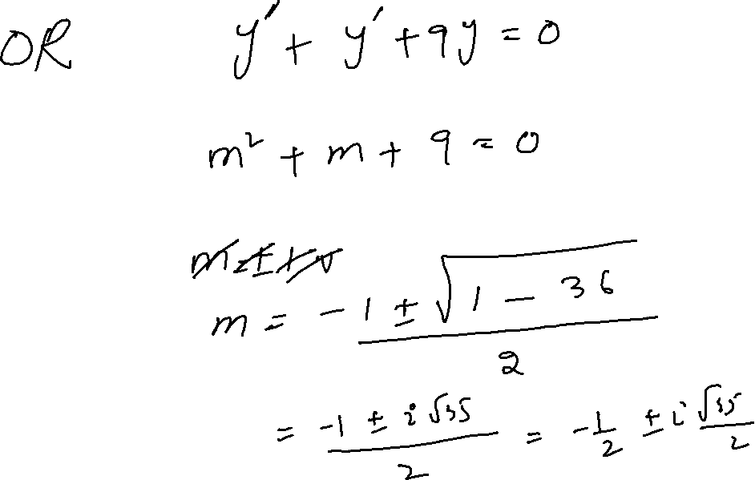

Slide 30
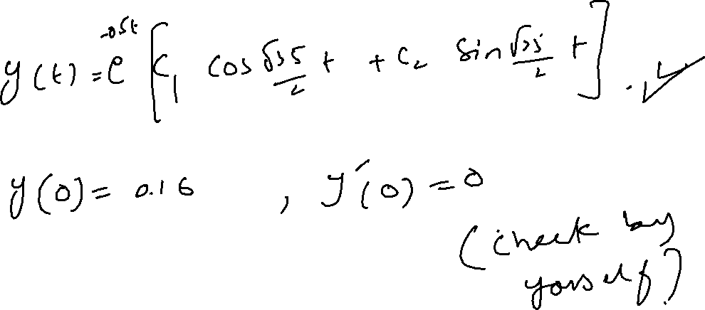

Slide 31






















